Slide 1
ConnectBud
Basics of Web App Development
Class 1
By: Rahul Joshi

Slide 2
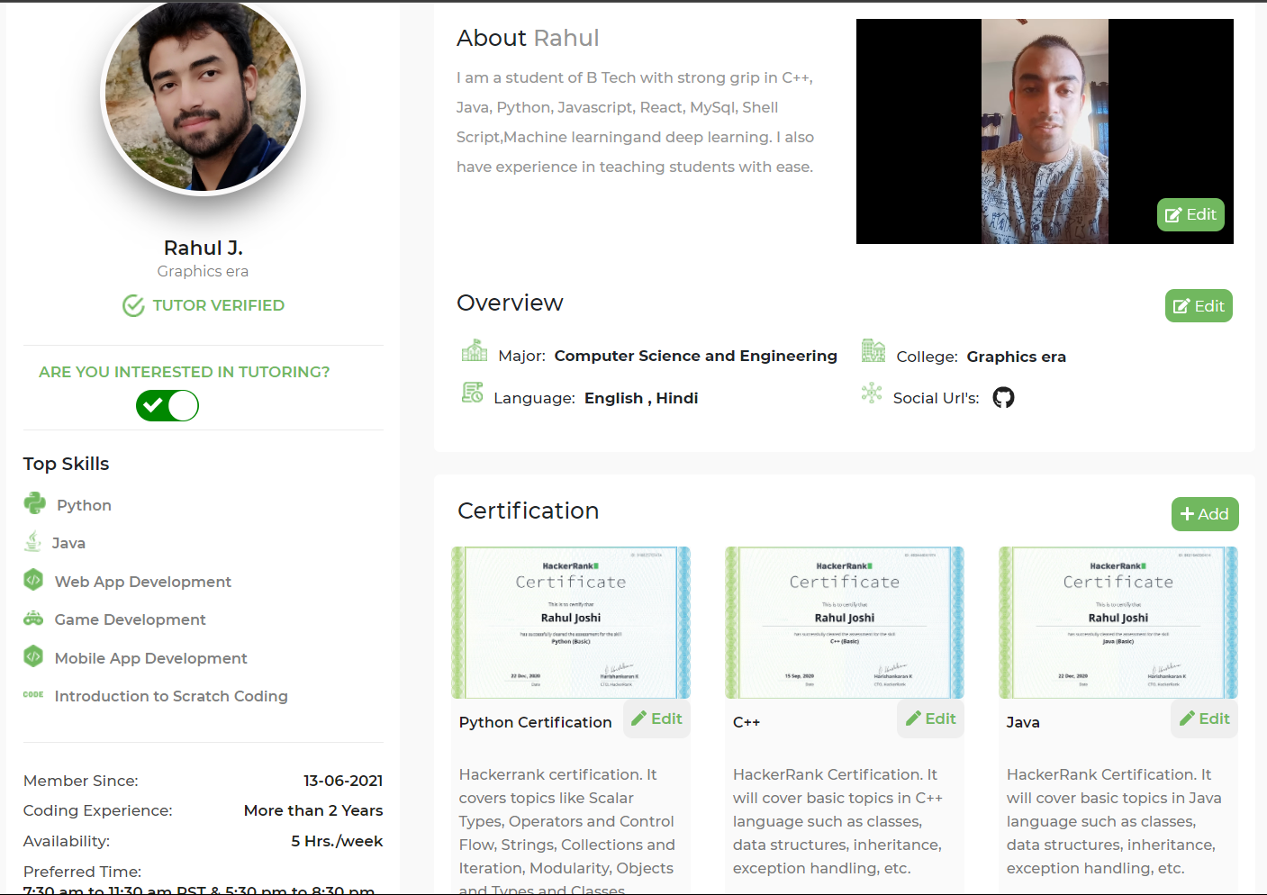

Slide 3
Course Overview
Class 1: • Basics of Web App Development
Class 2: • Advanced CSS and Page Layout
Class 3: • HTML/CSS Lab and Introduction to Programming
Class 4: • JavaScript Basics and Dev Tools

Slide 4
Web Page
Components
HTML
CSS
Javascript
What to display?
How to display?
(designing)
When to display?
(Functionalities)

Slide 5
What is HTML
HTML stands for Hyper Text Markup Language
Used to create Web pages.
It describes the structure of a Web page
It consists of a series of elements
HTML elements tell the browser what to display.

Slide 6
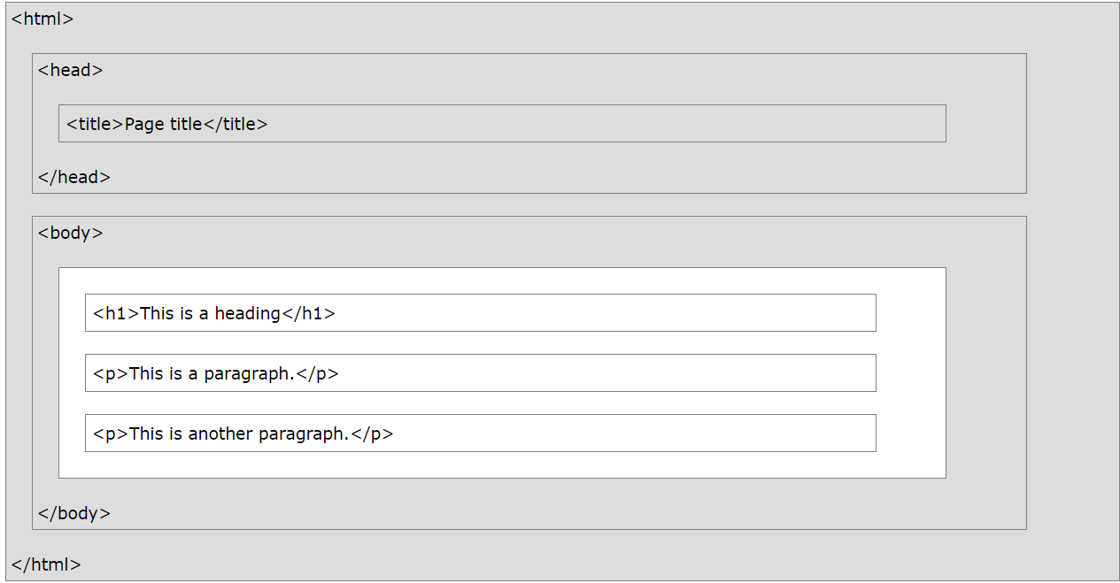
Structure of HTML document

Slide 7
Example
<html> <head> <title>
Page Title
</title> </head> <body> <h1>
Heading
</h1> <p>
My first
paragraph.
</p> </body> </html>
Example Explained:
The <html> element is the root element of an HTML page
The <head> element contains information about the HTML page.
The <title> element specifies a title for the HTML page (which is shown in the browser's title bar or in the page's tab)
The <body> element defines the document's body, and is a container for all the visible contents, such as headings, paragraphs, images, hyperlinks, tables, lists, etc.
The <h1> element defines a large heading.
The <p> element defines a paragraph.

Slide 8
Tags in HTML:
<p> :Paragraph
<h1>…..<h6> :Heading
<b> :Bold
<u> :Underline
<i> :Italics
<br> :Break
<big> :Increase font size
<small> :Decrease font size
<hr> :Horizontal line
<center> :Center Alignment
<strike> :Strike a word
<sup> :Superscript
<sub> :Subscript
<input> :Take Input
<button> :Button to click

Slide 9
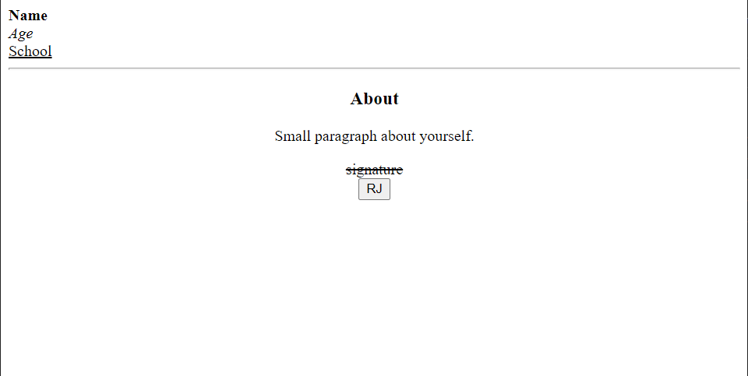
Homework Design a web page with following layout

Slide 10
End
For any queries: Contact:
Rahul Joshi rj26280218@gmail.com

